Slide 1
Lab 6: Rectification AC Signals, Transformers and Bridge Rectifiers
EE316-08 Spring 2021

Slide 2
Purpose: The goal of this laboratory is to explore AC signals, transformers and diodes. You will learn different methods of reporting AC voltages and learn how transformers and diodes can be utilized to rectify sinusoidal signals.

Slide 3
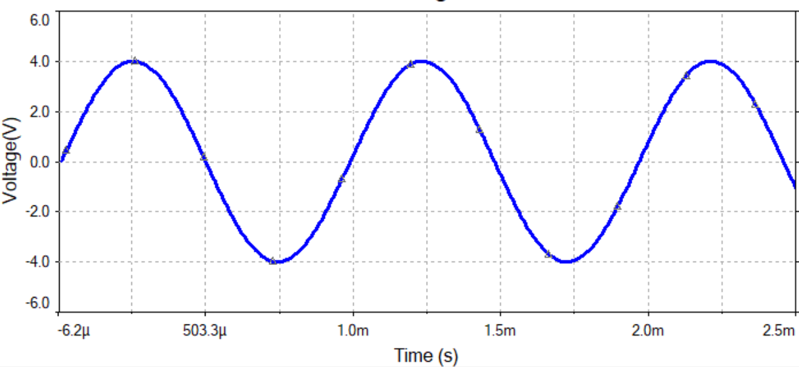
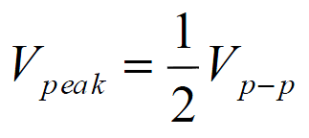
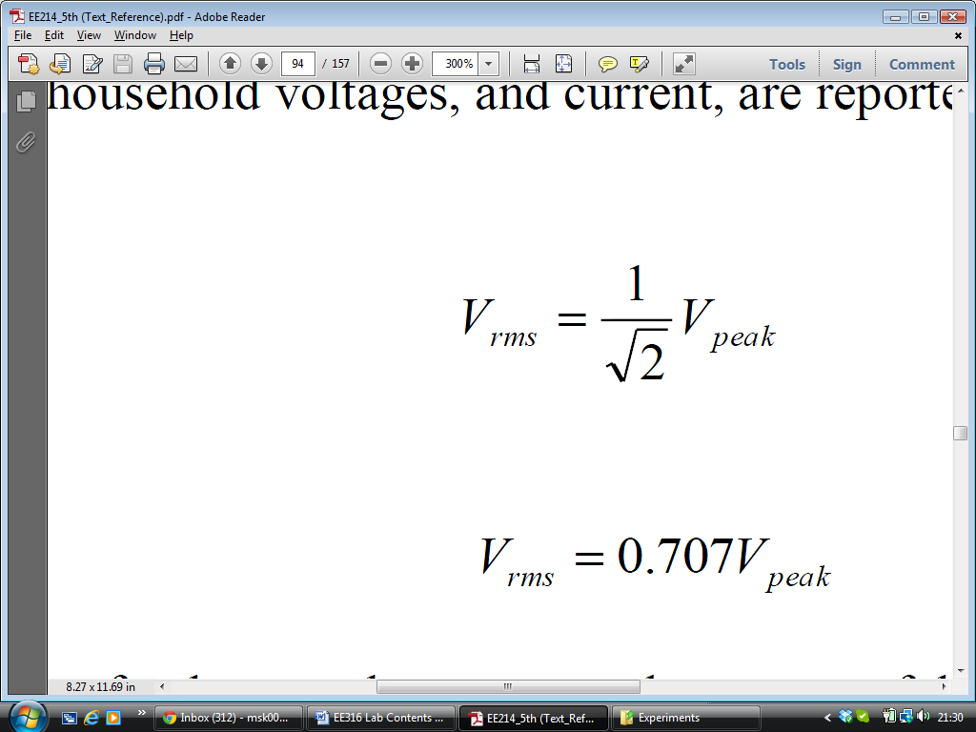

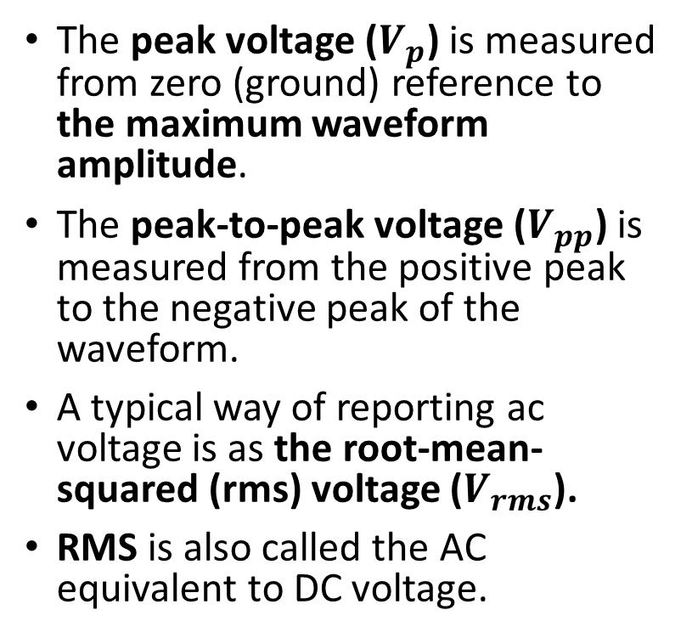



AC Waveforms
The peak voltage ($V_{p}$) is measured from zero (ground) reference to the maximum waveform amplitude.
The peak-to-peak voltage ($V_{pp}$) is measured from the positive peak to the negative peak of the waveform.
A typical way of reporting ac voltage is as the root-mean-squared (rms) voltage ($V_{rms}$).
RMS is also called the AC equivalent to DC voltage.
$$V_{rms}$$
$$V_{pp}$$
$$V_{p}$$
Half cycle
One full cycle
$V_{p−p}$ , $V_{peak}$ , and $V_{rms}$ Conversion

Slide 4





Find $V_{p−p}$ , $V_{peak}$ , and $V_{rms}$ of the following waveform
$$V_{rms}=\left(0.707\right)\left(4\right)=2.828 V$$
$$V_{rms}$$
$$V_{p}=4 V$$
$$V_{pp}=8 V$$

Slide 5
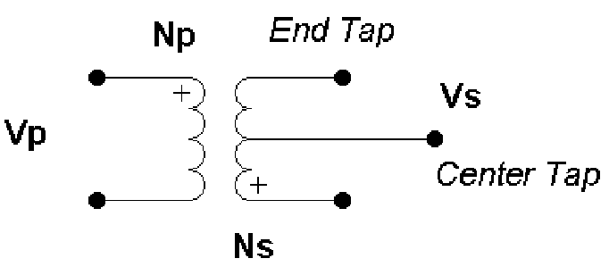
Transformer
A transformer is a device made of two or more coils. One coil is called the primary winding, and the other is called the secondary winding. The source voltage is applied to the primary winding while the load is connected to the secondary winding.
A transformer can be used to step up or down AC voltages and currents.
The step up or step down process occurs due to an induced EMF in the output side of the transformer.
The induced EMF is a direct result of the EMF in the input side of the transformer and magnetic coupling.
Vp is the primary (input) voltage
Vs is the secondary (output) voltage
Np is the number of turns of the primary coil
Ns is the number of turns of the secondary coil.
The primary winding
The secondary winding

Slide 6



Center-tapped (CT) Transformer
The CT is equivalent to two secondary windings.
If the secondary side is made up of two coils, the coils may be wound in the opposite direction of each other.
This allows for two different output voltages. One output voltage is between the top end tap and the center tap. The other voltage is between the center tap and the bottom.
$$V_{Top}$$
$V_{Total}=$ $V_{Top}$+ $V_{Bottom}$
$$V_{Bottom}$$

Slide 7
Center-tapped (CT) Transformer
Note: the center tap is usually at ground reference.
There is no requirement that the turn number be the same, in many cases a transformer will provide many different output voltages due to different coil wrappings.

Slide 8
Center-tapped (CT) Transformer
Output voltages with respect to the center tap are 180 degrees out of phase with each other.
Output Waveform (Top)
Input Waveform
Output Waveform (Bottom)

Slide 9
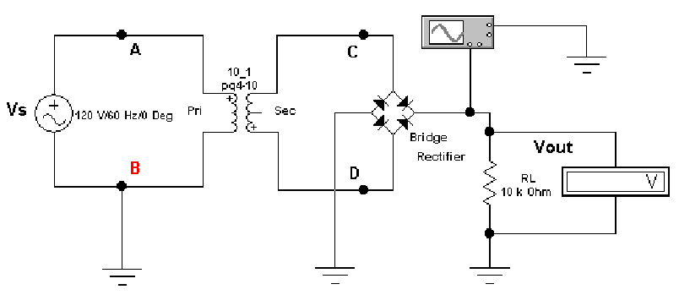
Center-tapped (CT) Transformer with Full Wave Rectifier
Rectifier takes two half-cycles output waveform and combines them together
Output Waveform
Input Waveform
Output Waveform after Rectifier

Slide 10
Center-tapped (CT) Transformer
Equations for an ideal transformer are
V_{s}N_{p} = V_{p}N_{s}
I_{s}N_{s} = I_{p}N_{p}
As an example, consider a V_{p} = 10 Vpeak sinusoidal input, N_{p} = 100, and N_{s} = 50 then:
V_{s} = (0.5)(10Vpeak) = 5Vpeak
V_{s} = (2)(5Vpeak) = 10Vpp
V_{s} = (0.7071)(5Vpeak) = 3.5Vrms

Slide 11
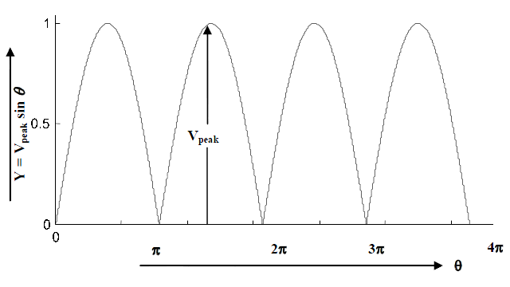
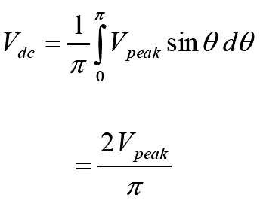
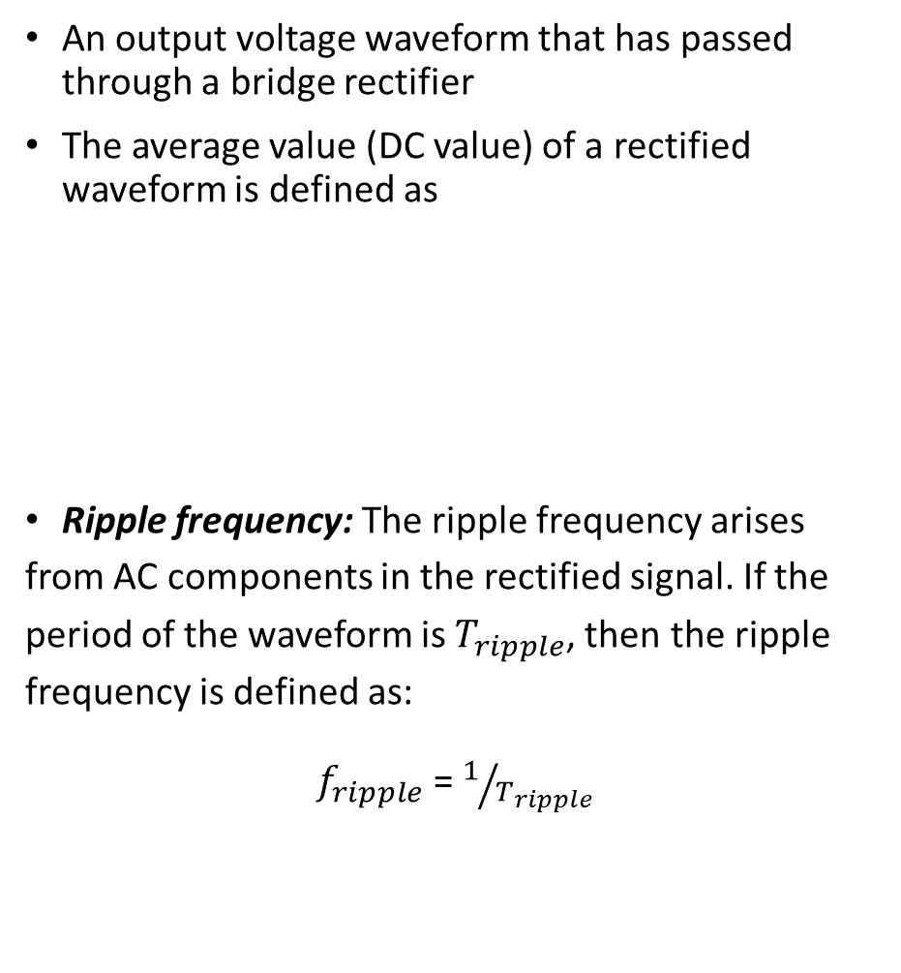
DC Value of Full-wave Rectifier Output
An output voltage waveform that has passed through a bridge rectifier
The average value (DC value) of a rectified waveform is defined as
Ripple frequency: The ripple frequency arises from AC components in the rectified signal. If the period of the waveform is$T_{ripple}$, then the ripple frequency is defined as:
$f_{ripple}$= $1/{T_{ripple}}$

Slide 12
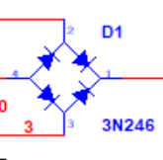
Multisim
For rectifier, search for 3N246 in components

Slide 13
Check out the following website for more information...
https://www.circuitbread.com/tutorials/center-tapped-full-wave-rectifier-operation

Slide 14
Summary
Lab 6 Report is due on Wednesday 3rd March 2021 by midnight.
Prelab 7 is due on Tuesday 9th March 2021 by midnight.
Midterm 1 will be available on CANVAS from March 2nd to March 9th.
Analyze Fig. 6.3 - 6.4
Simulation
Theoretical Analysis
Experimental section

